Slide 1
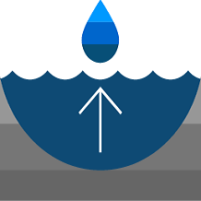
Groundwater Level Mapping Tool: Development of a Web Application to Effectively Characterize Groundwater Resources
Steven Evans
MS BYU

Slide 2

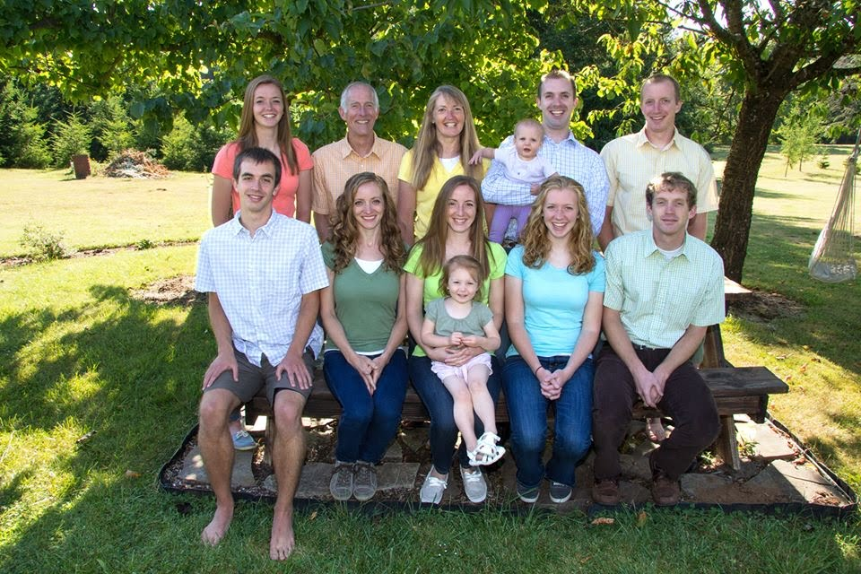

Acknowledgements
Dr. Rollin Hotchkiss
Dr. Wood Miller
Dr. Norm Jones
Dr. Dan Ames
Dr. Gus Williams
NASA
The Evans Family

Slide 3
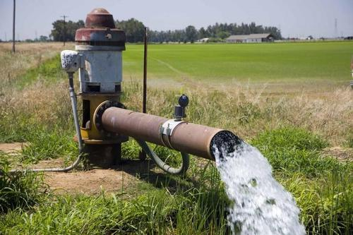
Groundwater Uses
Agricultural Irrigation
Drinking Water
Industrial Processes
Mining
Recharge for lakes, rivers, wetlands
Notes:
USGS: 30% of Earth’s fresh water is groundwater. 0.3% surface water
64% of groundwater is used for irrigation
51% of US population uses groundwater for drinking water. 99% of rural population uses groundwater for drinking water.
Photo: Apex International

Slide 4

Natural Groundwater Balance
Evapotranspiration
Precipitation
Recharge
Root Uptake
Discharge to Stream
Inflow
Outflow

Slide 5
Impacted Groundwater Balance
Evapotranspiration
Precipitation
Well Pumping
Recharge
Root Uptake
Discharge to Stream
Inflow
Outflow

Slide 6
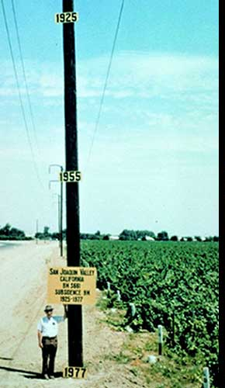
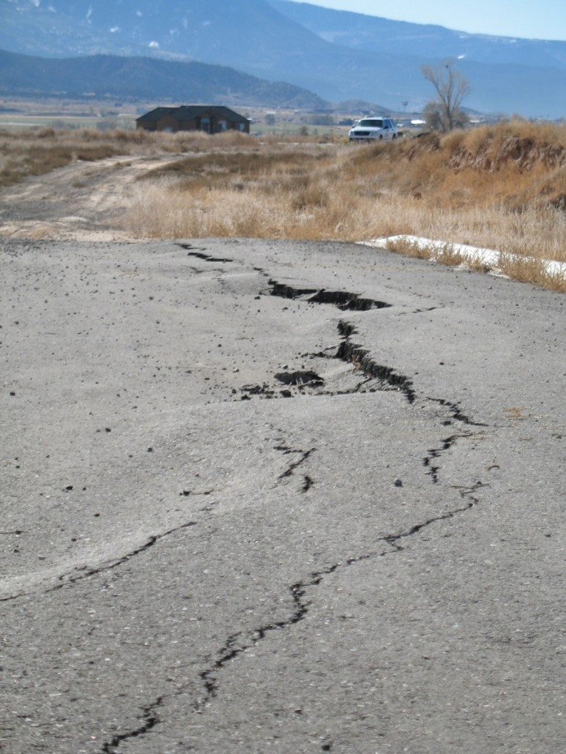
Loss of Groundwater Storage
Excessive pumping has resulted in land subsidence of up to 28 feet in California’s San Joaquin Valley since 1920.
Utah’s Cedar Valley has subsided as much as 4 feet since 1950.
Notes:
Excessive pumping drains aquifers of water. Pore space that was previously filled with water, which exerts pressure of 62.4 lb/ft^2 of depth is instead filled with air. Pore pressures decrease, which yield increased effective stress, which leads to compaction of the aquifer system. Pore space is reduce as the soil compresses and settles. This results in permanent aquifer storage loss as well as infrastructure and surface damage.
The dramatic case of the San Joaquin Valley demonstrates the role of human activity in aquifer sustainability. Between 1900 and 1960, the area relied exclusively on groundwater for irrigation. I n 1960, the USGS began an intensive investigation into groundwater in the area. A surface water began to supplant groundwater, the aquifer system made a dramatic recovery and land subsidence began to abate. This case demonstrates that policies and practices can be implemented to improve the sustainable use of groundwater when decision makers are informed and aware of the past and present conditions of their aquifer.
http://www.digitaljournal.com/tech-and-science/technology/sinking-san-joaquin-valley-of-california-seen-from-space/article/487393 Dick Ireland/USGS
https://geology.utah.gov/map-pub/survey-notes/land-subsidence-and-earth-fissures-in-cedar-valley/

Slide 7
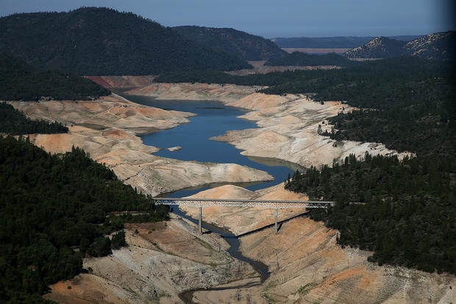
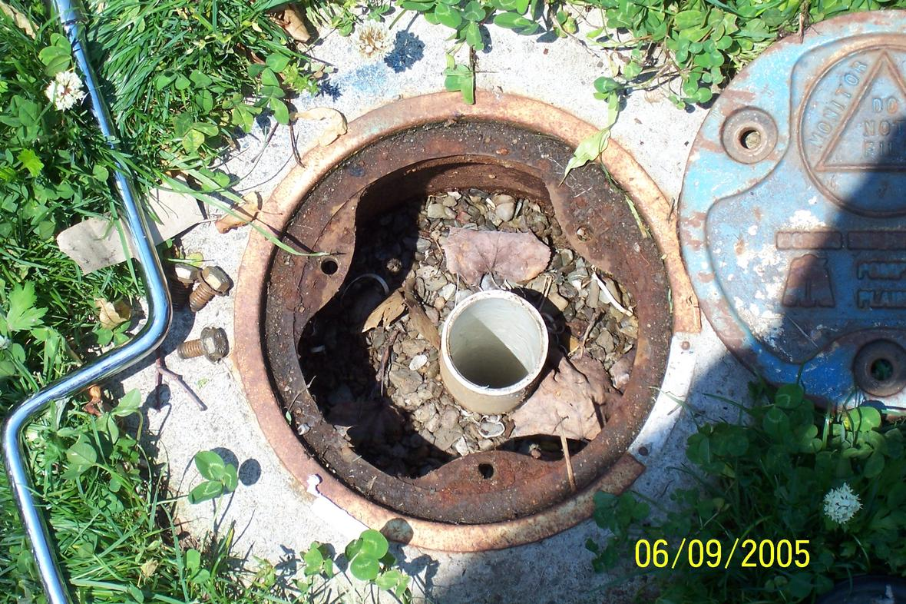
Difficulty Quantifying Groundwater
Notes:
Groundwater provides an abundant source of fresh water in many areas. One of the great challenges of managing this resource is the ability to quantify aquifer storage.
Here is Lake Oroville at 32% capacity. Quite easy to see.
Here is a USGS monitoring well, part of an aquifer-wide system of wells designed to monitor the groundwater. Our limited information comes from these wells, drilled throughout an aquifer, often sampled at irregular intervals.
https://www.cbsnews.com/pictures/california-drought-drains-lakes/16/ Justin Sullivan/Getty Images
https://www.usgs.gov/media/images/groundwater-monitoring-well-long-island-new-York Public Domain
Lake Oroville at 32 percent of its total 3,537,577 acre feet.
A USGS Monitoring Well on Long Island, New York

Slide 8
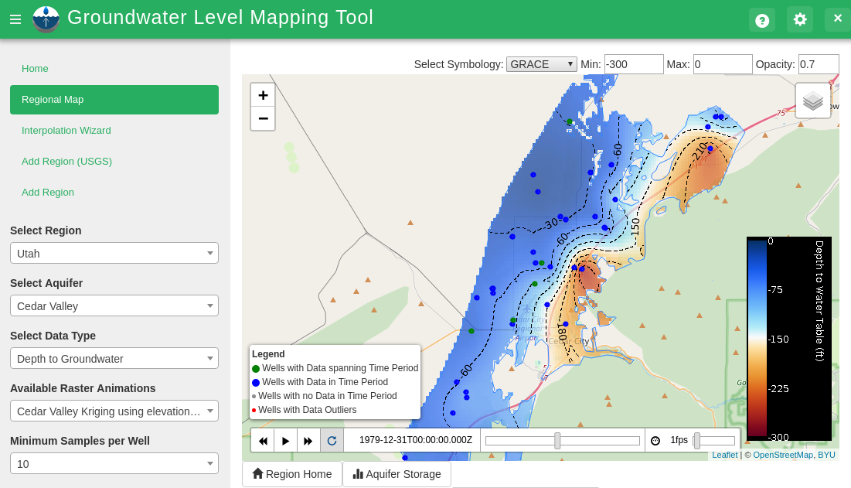
Groundwater Level Mapping Tool
Notes:
To overcome this challenge of aquifer quantification, I developed the Groundwater Level Mapping Tool, an open source, python-based web application built on the Tethys Platform developed at BYU.
This application allows water managers to view timeseries information for specific wells, view maps and animations of groundwater surface elevation, depth to groundwater, or aquifer drawdown, and to calculate changes in total aquifer storage.

Slide 9
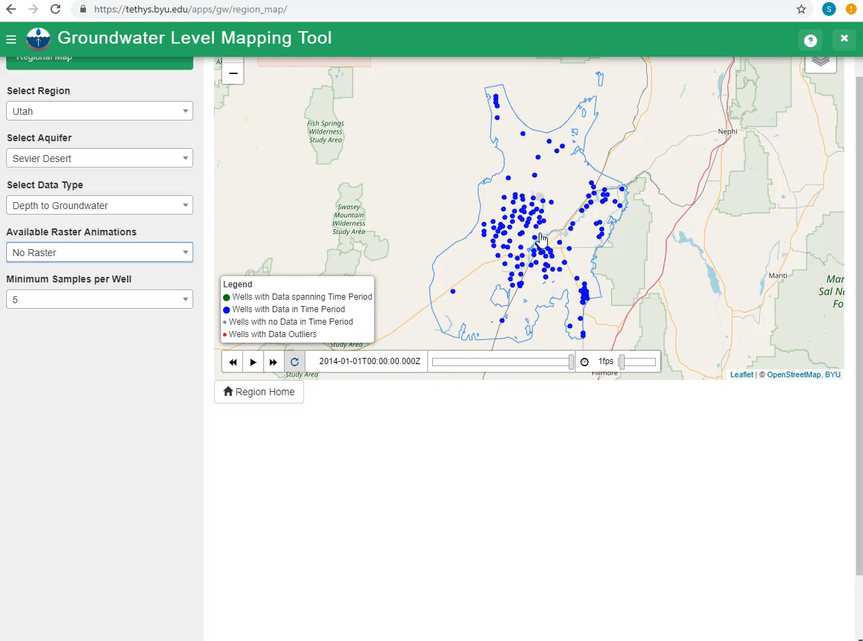
Notes:
Here is an example of using the app to view timeseries information at specific wells.
Note the large 20 year gap in data from 1945 to 1965.
Many wells have larger data gaps or have very little data.

Slide 10
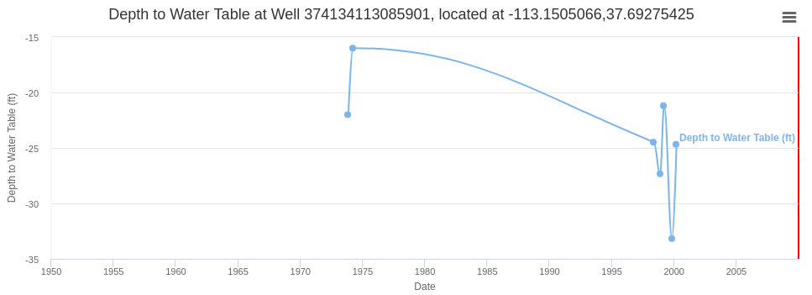
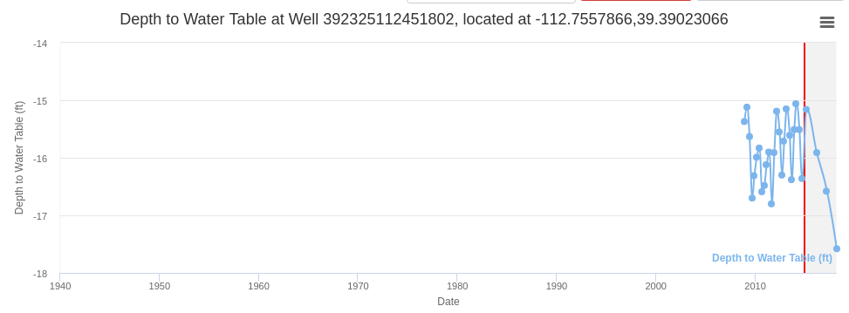
Temporally Sporadic Data
Well Time series often include large gaps in collected data
Some wells may only have data for one or two years
Notes:
Monitoring wells are often samples at irregular or sporadic intervals. It is not uncommon for monitoring wells to be abandoned, or to have quite brief periods of record. We may have only one or two years of information from a well.
How can we best make use of what little data we have?

Slide 11
Example of Correlation Throughout an Aquifer
Correlation between Wells in the Cedar Valley, UT Aquifer
Notes:
Because aquifers are geologically connected and their overlying lands are generally subject to similar climactic conditions, water levels within the same aquifer should exhibit similar trends and fluctuations over time. The magnitude may not be the same, but the trends should be similar. Shown here are the timeseries of three different wells in the Cedar Valley of Southern Utah. They exhibit similar trends and patterns, though the magnitude varies.

Slide 12
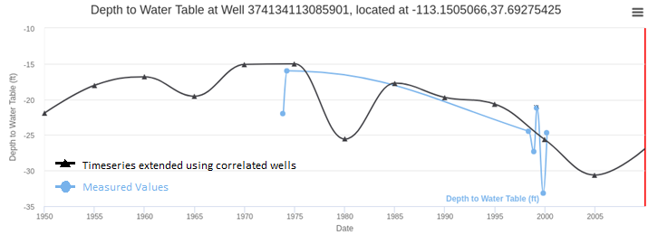
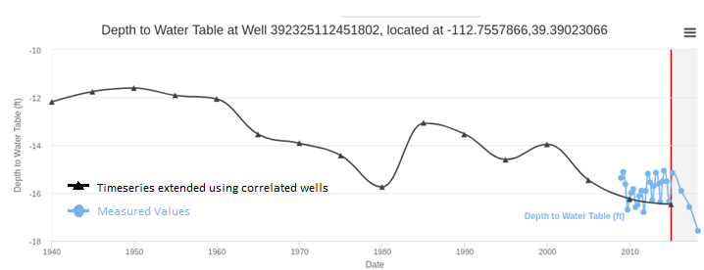
Temporal Interpolation and Extrapolation
Groundwater conditions often exhibit similar characteristics throughout an aquifer
Use the correlation between data from different wells in the aquifer to extrapolate and fill in missing data.
Notes:
We can use this correlation to extend the little timeseries data available to a longer period of record, making the scanty information useful for aquifer mapping and quantification. Often, there are several wells in an aquifer with long, accurate periods of record. We can take advantage of the inter-well correlation to extend the data of the temporally sporadic wells using the information from the detailed wells.

Slide 13
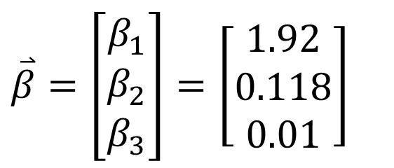
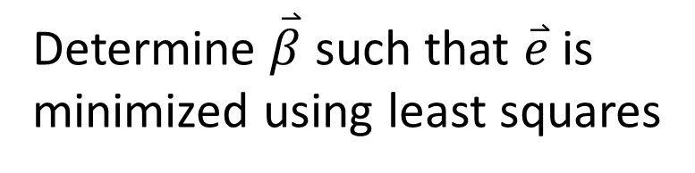
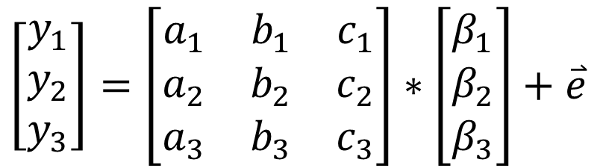
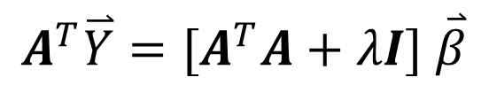
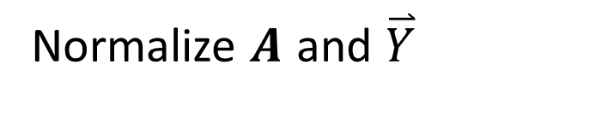
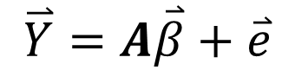
Multiple Linear Regression
$$\overset{⃑}{Y}=A\overset{⃑}{β}+\overset{⃑}{e}$$
Normalize $A$ and $\overset{⃑}{Y}$
$$\left[\begin{matrix}y_{1} \\ y_{2} \\ y_{3}\end{matrix}\right]=\left[\begin{matrix}a_{1} & b_{1} & c_{1} \\ a_{2} & b_{2} & c_{2} \\ a_{3} & b_{3} & c_{3}\end{matrix}\right]∗\left[\begin{matrix}β_{1} \\ β_{2} \\ β_{3}\end{matrix}\right]+\overset{⃑}{e}$$
Determine $\overset{⃑}{β}$ such that $\overset{⃑}{e}$ is minimized using least squares
$$A^{T}\overset{⃑}{Y}=[A^{T}A+λI] \overset{⃑}{β}$$
$\overset{⃑}{β}=\left[\begin{matrix}β_{1} \\ β_{2} \\ β_{3}\end{matrix}\right]=\left[\begin{matrix}1.92 \\ 0.118 \\ 0.01\end{matrix}\right]$
Notes:
Multi-linear regression assumes that Y is a linear combination of the values A. The rows are timesteps, the columns are wells
The A matrix is regularized timeseries values of the reference wells at time steps 1,2, and 3. Each value is normalized by subtracting the minimum and then dividing the difference by the range (max-min).
I used a regularization term of .005 in my tests

Slide 14
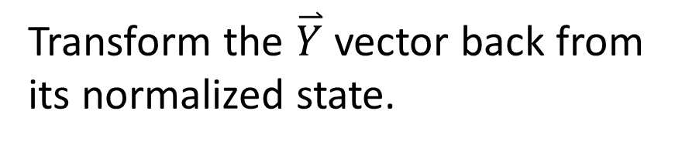
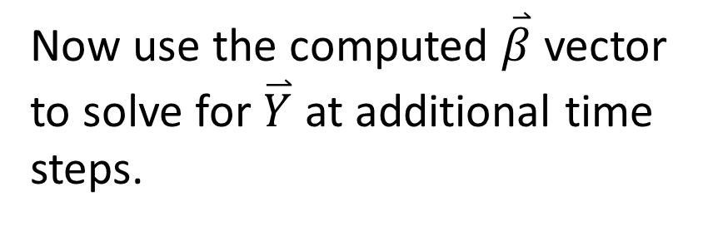
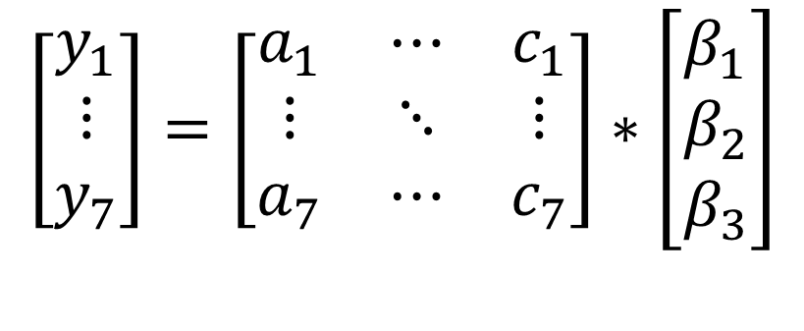
Multiple Linear Regression
Now use the computed $\overset{⃑}{β}$ vector to solve for $\overset{⃑}{Y}$ at additional time steps.
$$\left[\begin{matrix}y_{1} \\ ⋮ \\ y_{7}\end{matrix}\right]=\left[\begin{matrix}a_{1} & ⋯ & c_{1} \\ ⋮ & ⋱ & ⋮ \\ a_{7} & ⋯ & c_{7}\end{matrix}\right]∗\left[\begin{matrix}β_{1} \\ β_{2} \\ β_{3}\end{matrix}\right]$$
Transform the $\overset{⃑}{Y}$ vector back from its normalized state.
Notes:
Retransform Y by multiplying each entry by the range of the original Y data (max-min) and then adding the min.

Slide 15
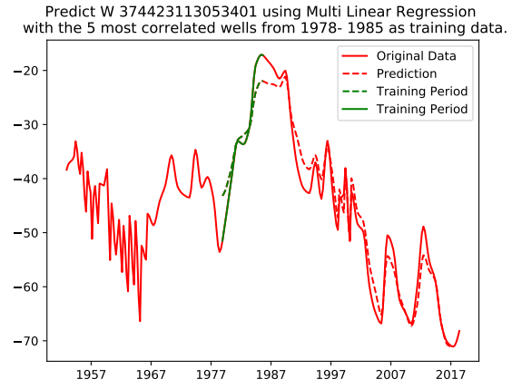
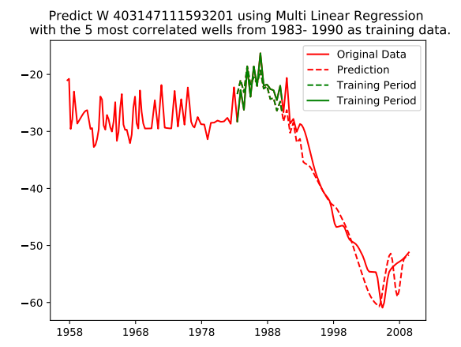
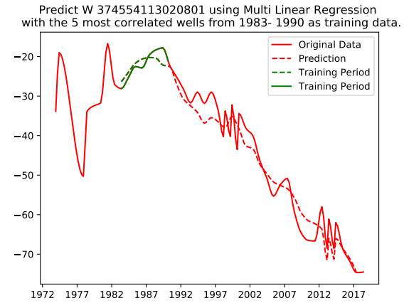
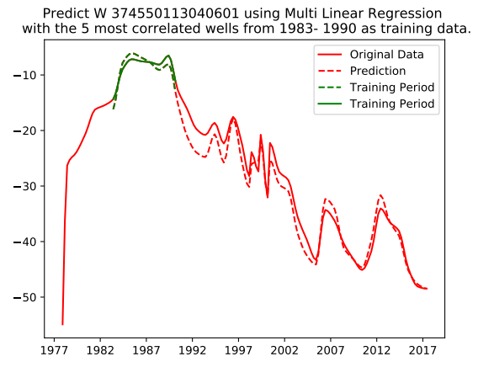
Test Results of Multiple Linear Regression
Tested 407 wells in Ogallala aquifer
Mean Absolute Error: 6 ft
Median Absolute Error: 3 ft
Tested 10 wells in Cedar Valley
Mean Absolute Error: 3 ft
Median Absolute Error: 2 ft
Outperformed Kriging spatial interpolation
Notes:
Tested this method of regression using hundreds of wells in different aquifers. Some results are better than these and some are worse.
Range normalized RMSE was .07-.1
417 wells in Ogallala Aquifer predicting 15 years: Mean Absolute Error: 6 ft (4%), Median Absolute Error: 3 ft (2%).
Kriging (19 ft median, 26 ft mean error)

Slide 16
Comparison of MLR Results with Kriging
MLR Interpolation
Kriging Interpolation
December 2014 WSEL estimated at each well using data from 1985-1995 as training data
Mean Absolute Error:
3.5 ft
December 2014 WSEL estimated using jackknife approach of Kriging spatial interpolation
Mean Absolute Error:
19.1 ft

Slide 17
Extrapolation based on Earth Observations
Groundwater levels are correlated with soil moisture models, drought indicators, and other Earth observations.
Palmer Drought Severity Index (PDSI)
Global Land Data Assimilation (GLDAS) Root Zone Soil Moisture
Climate Prediction Center (CPC) Soil Moisture
Gravity Recovery and Climate Experiment (GRACE) Total Water Storage
Notes:
In some cases, there may not be any wells in an aquifer with a long period of record. In this case, we can use Earth observations to infer missing groundwater data. Groundwater levels are correlated with soil moisture and drought indicators.
The PDSI is a drought index based on temp and precip that measures relative dryness
Soil moisture is estimated using a one-layer hydrologic model based on temp and precip
The best correlation to groundwater it the Total water storage anomaly measured by GRACE, but this mission doesn’t have enough data for sufficient testing currently, since it was only launched in 2002.

Slide 18
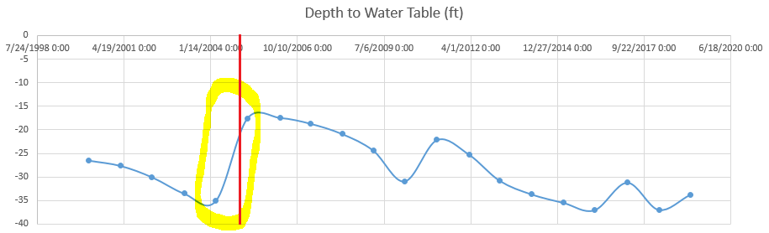
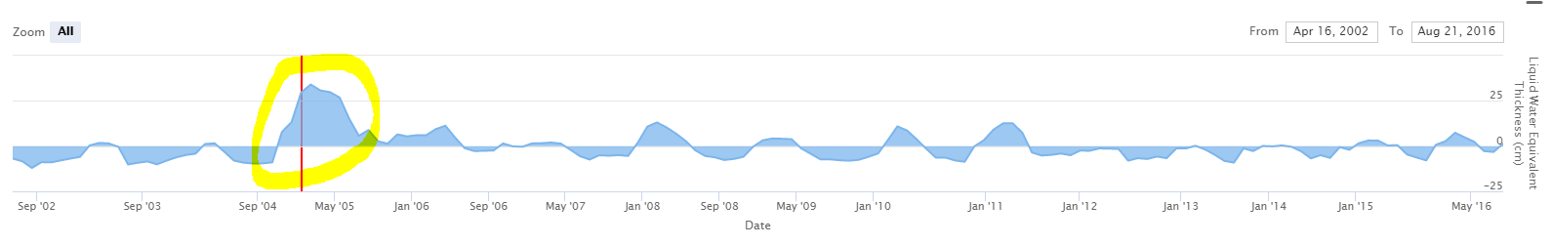
Groundwater compared to Soil Moisture
GLDAS Soil Moisture Liquid Water Equivalent Thickness (cm)
Notes:
In this case, the correlation between soil moisture or PDSI and groundwater levels is not linear. But there is a correlation, as shown here. The spring of early 2005 in Southwest Utah produced exceptionally high soil moisture values. This corresponds to a rise of the phreatic surface at the same location at the same time. The non-linear relationship between theses variables can be used to extend groundwater timeseries information using machine learning techniques.

Slide 19
Inputs for Machine Learning Estimation
Monthly values, and 1, 3, 5, and 10- year rolling averages of PDSI and Soil Moisture are used as inputs for machine learning.
These rolling averages improve the accuracy of the estimation by capturing the effects of long- and short-term climatic events which contribute to changes in groundwater levels.
All data is normalized to a range between 0 and 1
Notes:
Monthly, 1, 3, 5, and 10 year rolling averages of PDSI and soil moisture are used as inputs for the machine learning process.
These averages help account for long and short-term climactic events which contribute to changes in groundwater levels.
The data is normalized to a range between 0 and 1, the same as in the MLR method.

Slide 20
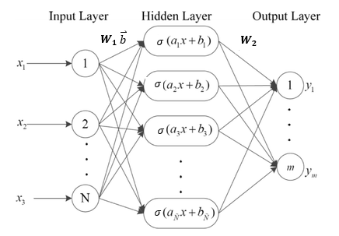
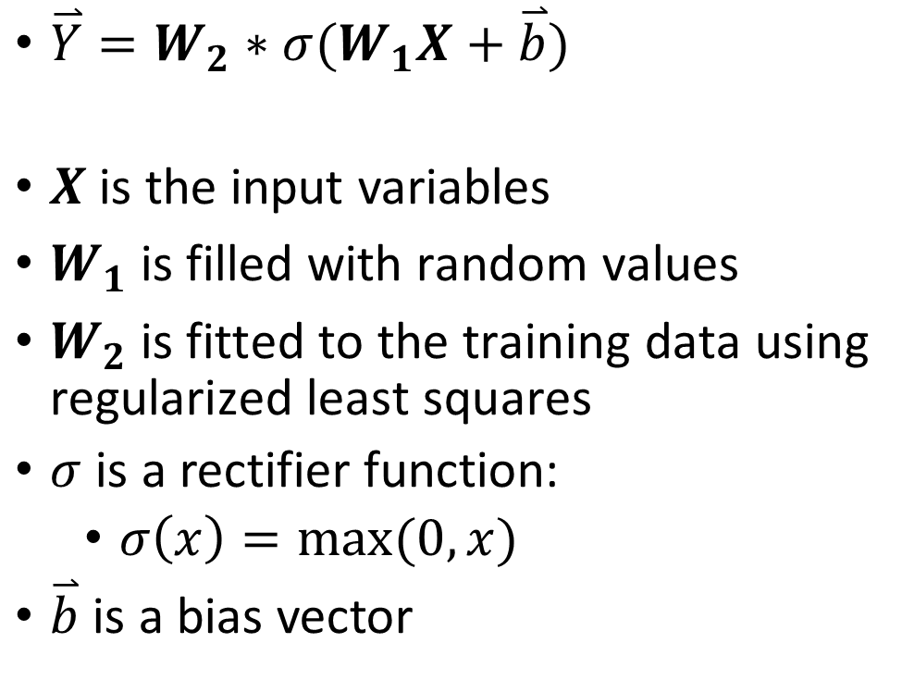
Extreme Learning Machine
$\overset{⃑}{Y}=W_{2}∗σ(W_{1}X+\overset{⃑}{b})$
$X$ is the input variables
$W_{1} \text{is} \text{filled} \text{with} \text{random} \text{values}$
$W_{2} \text{is} \text{fitted} \text{to} \text{the} \text{training} \text{data} \text{using} \text{regularized} \text{least} \text{squares}$
$σ$ is a rectifier function:
$σ\left(x\right)=max(0,x)$
$\overset{⃑}{b}$ is a bias vector
Notes:
The extreme learning machine is used to determine the weights W2 for randomly initialized matrix W1 that best fit the training data. W1 is a 17x100 matrix, and W2 is a 100 x number of timestep matrix.
Once the weight matrixes are determined, we can estimate water levels for any time where we have satellite observations.

Slide 21
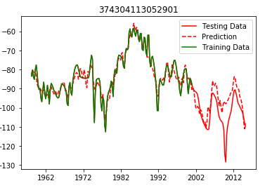
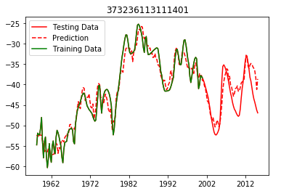
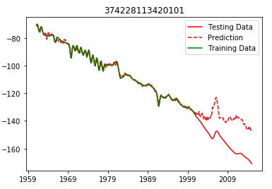
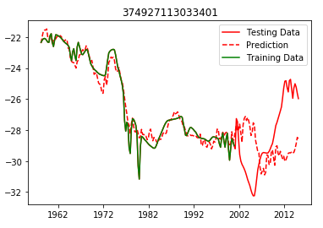
Test Results of Extreme Learning Machine
Results were relatively accurate in areas not subject to excessive groundwater pumping.
Results were less accurate in areas with excessive pumping.
Some results may have been adversely affected by the coarse resolution of PDSI and SM grids.
Notes:
This method yielded results less accurate than the MLR method. Results were best in areas not subjected to heavy pumping activity. Results were less accurate in areas of excessive groundwater pumping. It is also seems that the model was adversely affected by the coarse resolution of the PDSI and GLDAS data that I used, which were .25 degree resolution. Results were better in some areas of the cell than others.

Slide 22
Comparison of ELM Results with Kriging
Cedar Valley Aquifer
ELM Interpolation
Kriging Interpolation
December 2014 WSEL estimated at each well using data from 1980-2000 as training data
Mean Absolute Error:
6 ft
December 2014 WSEL estimated using jackknife approach of Kriging spatial interpolation
Mean Absolute Error:
11 ft

Slide 23
Comparison of ELM Results with Kriging
Beryl-Enterprise Aquifer
ELM Interpolation
Kriging Interpolation
December 2014 WSEL estimated at each well using data from 1980-2000 as training data
Mean Absolute Error:
25 ft
December 2014 WSEL estimated using jackknife approach of Kriging spatial interpolation
Mean Absolute Error:
6 ft

Slide 24
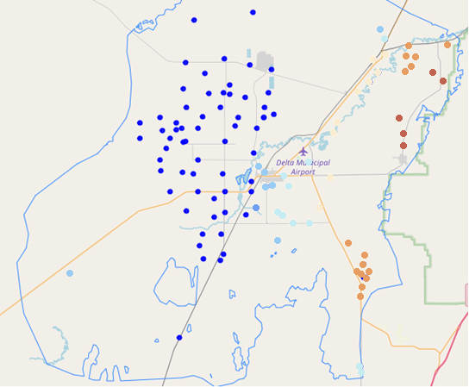
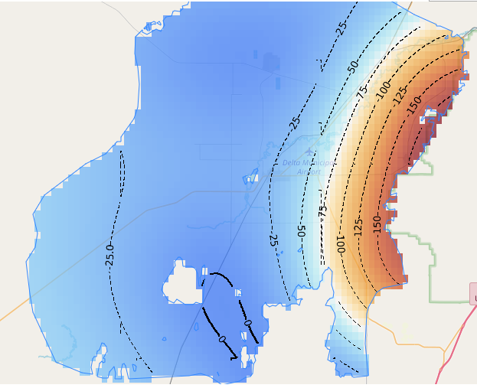
Spatial Interpolation using Kriging
Notes:
After the timeseries analysis, we now have values of depth to groundwater and water table elevation for specific timesteps at specific locations. Now we want to use this information to predict values throughout the entire aquifer, producing a map like the one on the right. We accomplish this by using the Kriging Geospatial Interpolation technique, using the GSLIB code developed at Stanford. I sort the distance/semi-variance couplets into bins and then use these to automatically fit a spherical variogram to the data.

Slide 25
Kriging Interpolation
Given values $Z_{1}$ . . . $Z_{n}$ at locations ($x_{1}$, $y_{1}$) . . . ($x_{n}$, $y_{n}$)
Estimate a value $Z_{∗}$ at location ($x_{∗}$, $y_{∗}$)
$Z_{∗}$=$\sum_{i=1}^{n}{λ_{i}Z_{i}}$
$λ_{i}$ are weights for each data point $Z_{i}$
Weights ${(λ}_{i})$are determined by use of a variogram

Slide 26
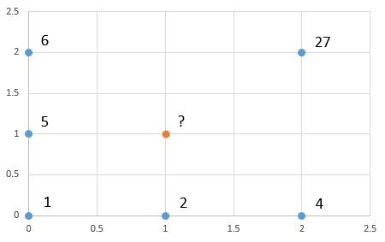
Developing a Variogram
For each couplet of points, determine the distance $d\left(1,2\right)=\sqrt{{\left(x_{1}−x_{2}\right)}^{2}+{\left(y_{1}−y_{2}\right)}^{2} }$ and the semivariance V(1,2)=$\frac{{(z_{1}−z_{2})}^{2}}{2}$ between the points
d=2.0, v=220.5
d=2.0, v=264.5
d=1.0, v=2.0

Slide 27
Defining a Variogram Model
Sort data into bins
Calculate average d and v for each bin
Spherical Variogram Model:
V(d) = $\left\{\begin{aligned}n+p\left(1.5\frac{d}{r}−.5{\left(\frac{d}{r}\right)}^{3}\right) d\text{≤}r \\ p+n d\text{>}r\end{aligned}\right.$
Parameters: Nugget (n), Range (r), and Partial Sill (p)
Use least squares optimization to fit spherical variogram to averages by adjusting n, r, and p parameters
Notes:
In the Groundwater Level Mapping Tool, I use a spherical variogram model since this was suggested by much of the literature and it produced the best fit for the aquifers that I analyzed. Fitting a variogram is difficult. I fit my variogram automatically by sorting the distance and semivariance values into bins and then caluculating an average for each bin and then using scipy.optimize least squares to minimize the variogram residuals (experimental semivariance minus modelled semivariance) by adjusting the nugget, sill, and range within specified bounds.

Slide 28
Solve the Kriging System
$\left[\begin{matrix}V(1,1) & ⋯ & V(1,n) & 1 \\ ⋮ & ⋱ & ⋮ & 1 \\ \begin{aligned}V(n,1) \\ 1\end{aligned} & \begin{aligned}⋯ \\ 1\end{aligned} & \begin{aligned}V(n,n) \\ 1\end{aligned} & \begin{aligned}1 \\ 0\end{aligned}\end{matrix}\right]∗\left[\begin{matrix}λ_{1} \\ ⋮ \\ λ_{n+1}\end{matrix}\right]=\left[\begin{matrix}V\left(∗,1\right) \\ ⋮ \\ \begin{aligned}V\left(∗,n\right) \\ 1\end{aligned}\end{matrix}\right]$
Solve the matrix equation for the weights ${(λ}_{i}$)
Calculate the solution $Z_{∗}$ at location ($x_{∗}$, $y_{∗}$)
$Z_{∗}$=$\sum_{i=1}^{n}{λ_{i}Z_{i}}$
Apply this method throughout the aquifer to create a map of groundwater levels
Notes:
In the Groundwater Mapping Tool, I use an Ordinary Kriging Interpolation Method using the GSLIB Fortran Code developed by Stanford University.

Slide 29
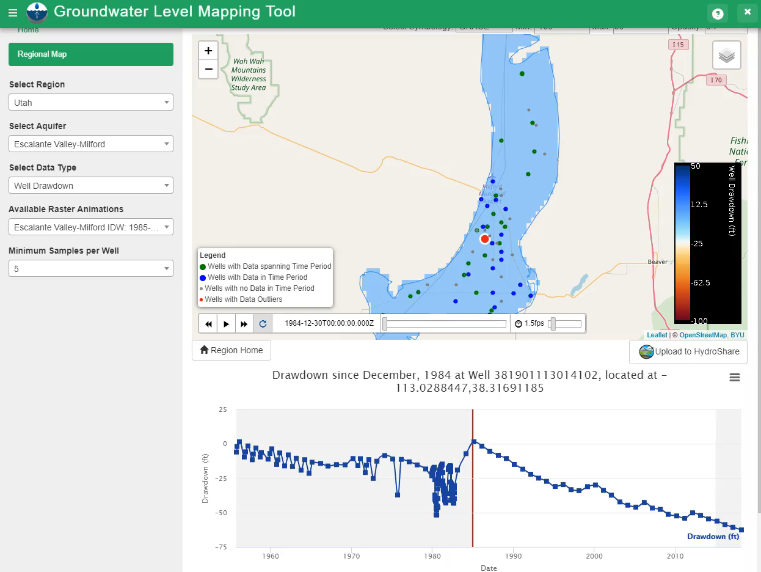
View Maps of Groundwater Drawdown
Notes:
With our temporal and spatial interpolation complete, we can now map changes in groundwater levels through time. Here is an example of mapping drawdown in the Milford area of the Escalante Valley in southern Utah.

Slide 30
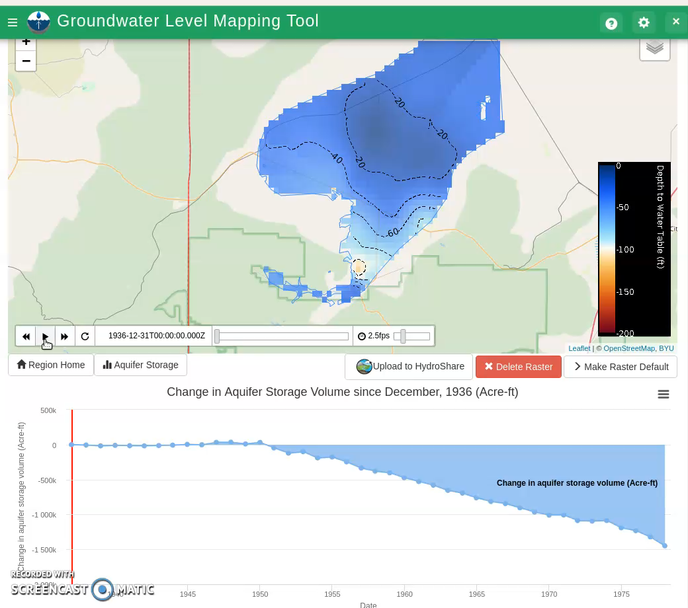
Calculate Aquifer Depletion
Multiply drawdown by cell area and storage coefficient, then sum over the aquifer.
Calculated 1.45 million acre-ft storage loss in Beryl-Enterprise area from 1937-1978.
USGS calculated 1.3-1.5 million acre-ft loss for same period.
Notes:
Using the values calculated in the drawdown raster, we can estimate the volume of aquifer depletion. For each cell in the raster, we multiply the drawdown by its cell area and the storage coefficient (storativity or specific storage) and then sum these values over the aquifer, giving us an estimate of aquifer storage volume change. Using the USGS estimate of 0.2 as the storage coefficient, I calculated a storage loss of 1.45 million acre-feet between 1937 and 1978. The USGS estimated drawdown between 1.3 and 1.5 million acre-feet for this area. Current depletion rate is approximately 66,000 acre-feet per year.
By using the Groundwater Level Mapping Tool, we can better manage our precious groundwater resources. We can identify trends in groundwater and act to promote sustainable groundwater programs and limit withdrawals before it is too late and permanently lose aquifer storage. By doing so, we can make sure that we, and those who come after us, will have access to this life giving liquid.

Slide 31
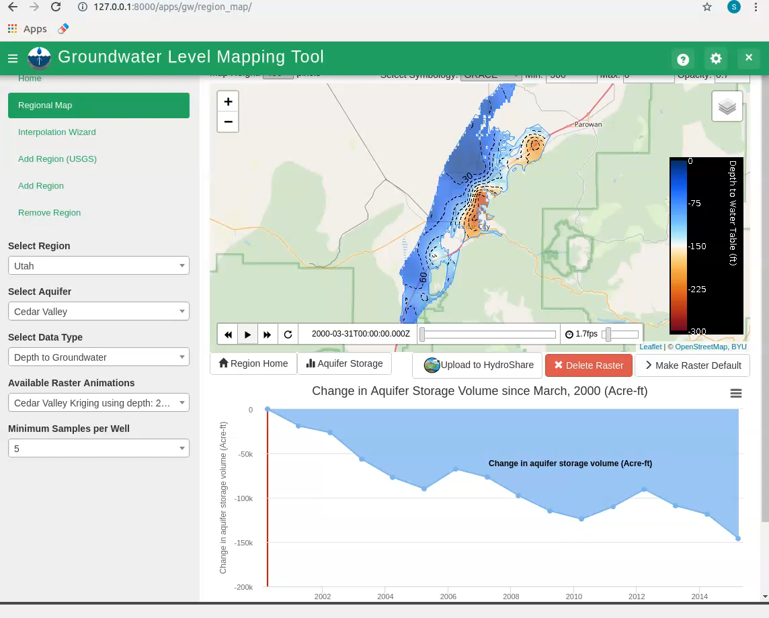
Aquifer Depletion in Cedar Valley
Calculated 8,300 acre-ft per year storage loss in Cedar Valley
Utah DWR concluded storage loss of 7,600 acre-ft per year
Notes:
The automated estimate from the Groundwater Mapping Tool for the Cedar Valley Aquifer was also relatively accurate. Calculated loss was similar to the Division of Water Rights estimate and the Geological Survey estimate.
By using the Groundwater Level Mapping Tool, we can get better manage our precious groundwater resources. We can identify trends in groundwater and act to promote sustainable groundwater programs and limit withdrawals before it is too late and permanently lose aquifer storage. By doing so, we can make sure that we, and those who come after us, will have access to this life giving liquid.

Slide 32

Thank you
Notes:
By using the Groundwater Level Mapping Tool, we can get better manage our precious groundwater resources. We can identify trends in groundwater and act to promote sustainable groundwater programs and limit withdrawals before it is too late and permanently lose aquifer storage. By doing so, we can make sure that we, and those who come after us, will have access to this life giving liquid.

